Slide 1

Indexed Search Tree (Trie)
Nelson Padua-Perez
Chau-Wen Tseng
Department of Computer Science
University of Maryland, College Park

Slide 2
Indexed Search Tree (Trie)
Special case of tree
Applicable when
Key C can be decomposed into a sequence of subkeys C₁, C₂, … C_{n}
Redundancy exists between subkeys
Approach
Store subkey at each node
Path through trie yields full key
Example
Huffman tree
C₁
C₂
C₃
C₃
C₄

Slide 3
Tries
Useful for searching strings
String decomposes into sequence of letters
Example
“ART” ⇒ “A” “R” “T”
Can be very fast
Less overhead than hashing
May reduce memory
Exploiting redundancy
May require more memory
Explicitly storing substrings
A
R
S
E
T
“ART”

Slide 4
Types of Tries
Standard
Single character per node
Compressed
Eliminating chains of nodes
Compact
Stores indices into original string(s)
Suffix
Stores all suffixes of string

Slide 5
Standard Tries
Approach
Each node (except root) is labeled with a character
Children of node are ordered (alphabetically)
Paths from root to leaves yield all input strings
Trie for Morse Code

Slide 6
Standard Trie Example
For strings
{ a, an, and, any, at }

Slide 7
Standard Trie Example
For strings
{ bear, bell, bid, bull, buy, sell, stock, stop }

Slide 8
Standard Tries
Node structure
Value between 1…m
Reference to m children
Array or linked list
Example
Class Node {
Letter value; // Letter V = { V₁, V₂, … V_{m} }
Node child[ m ];
}

Slide 9
Standard Tries
Efficiency
Uses O(n) space
Supports search / insert / delete in O(d×m) time
For
n total size of strings indexed by trie
d length of the parameter string
m size of the alphabet

Slide 10
Word Matching Trie
Insert words into trie
Each leaf stores occurrences of word in the text

Slide 11
Compressed Trie
Observation
Internal node v of T is redundant if v has one child and is not the root
Approach
A chain of redundant nodes can be compressed
Replace chain with single node
Include concatenation of labels from chain
Result
Internal nodes have at least 2 children
Some nodes have multiple characters

Slide 12
Compressed Trie
Example

Slide 13
Compact Tries
Compact representation of a compressed trie
Approach
For an array of strings S = S[0], … S[s-1]
Store ranges of indices at each node
Instead of substring
Represent as a triplet of integers (i, j, k)
Such that X = s[i][j..k]
Example: S[0] = “abcd”, (0,1,2) = “bc”
Properties
Uses O(s) space, where s = # of strings in the array
Serves as an auxiliary index structure

Slide 14
Compact Representation
Example

Slide 15
Suffix Trie
Compressed trie of all suffixes of text
Example: “IPDPS”
Suffixes
IPDPS
PDPS
DPS
PS
S
Useful for finding pattern in any part of text
Occurrence ⇒ prefix of some suffix
Example: find PDP in IPDPS
D
I
P
P
P
S
D
D
P
S
P
S
S
S

Slide 16
Suffix Trie
Properties
For
String X with length n
Alphabet of size m
Pattern P with length d
Uses O(n) space
Can be constructed in O(n) time
Find pattern P in X in O(d×m) time
Proportional to length of pattern, not text

Slide 17
Suffix Trie Example

Slide 18
Tries and Web Search Engines
Search engine index
Collection of all searchable words
Stored in compressed trie
Each leaf of trie
Associated with a word
List of pages (URLs) containing that word
Called occurrence list
Trie is kept in memory (fast)
Occurrence lists kept in external memory
Ranked by relevance

Slide 19
Computational Biology
DNA
Sequence of 4 different nucleotides (ATCG)
Portions of DNA sequence produce proteins (genes)
Genome
Master DNA sequence for organism
For Human
46 chromosomes
3 billion nucleotides

Slide 20
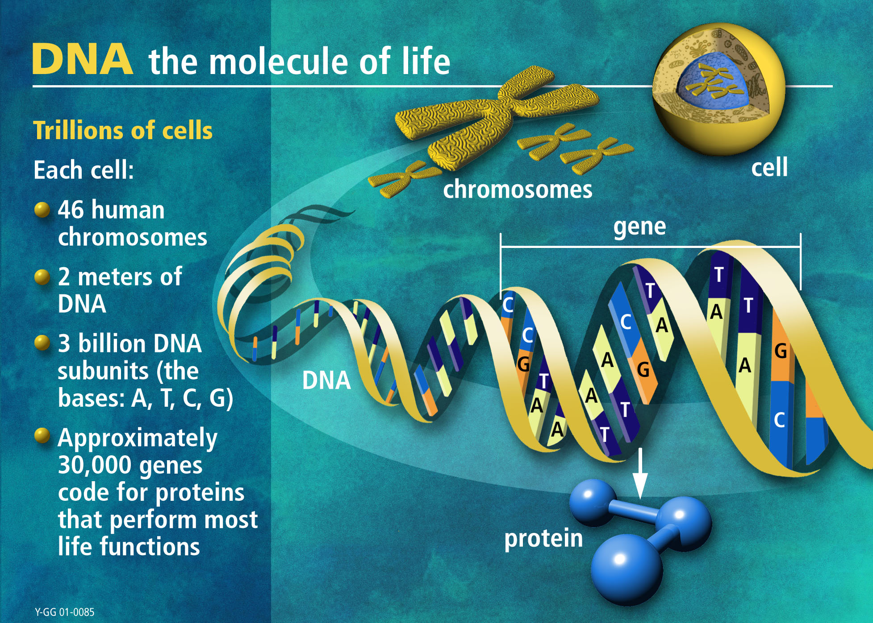
Notes:
DNA in the human genome is arranged into 24 distinct chromosomes--physically separate molecules that range in length from about 50 million to 250 million base pairs. A few types of major chromosomal abnormalities, including missing or extra copies or gross breaks and rejoinings (translocations), can be detected by microscopic examination. Most changes in DNA, however, are more subtle and require a closer analysis of the DNA molecule to find perhaps single-base differences.
Each chromosome contains many genes, the basic physical and functional units of heredity. Genes are specific sequences of bases that encode instructions on how to make proteins. Genes comprise only about 2% of the human genome; the remainder consists of noncoding regions, whose functions may include providing chromosomal structural integrity and regulating where, when, and in what quantity proteins are made. The human genome is estimated to contain 30,000 to 40,000 genes.
Although genes get a lot of attention, it’s the proteins that perform most life functions and even make up the majority of cellular structures. Proteins are large, complex molecules made up of smaller subunits called amino acids. Chemical properties that distinguish the 20 different amino acids cause the protein chains to fold up into specific three-dimensional structures that define their particular functions in the cell.

Slide 21
Tries and Computational Biology
ESTs
Fragments of expressed DNA
Indicator for genes (& location)
5.5 million sequences at NIH
ESTmapper
Build suffix trie of genome
8 hours, 60 Gbytes
Search for ESTs in suffix trie
11 hours w/ 8 processor Sun
Search genome w/ BLAST
5⁺ years (predicted)
Genome
Suffix tree
ESTs
Mapping
Gene

